Slide 1


Bitcoin Price Prediction
GROUP MEMBERS:-
VAISHNAVI H ALVA (01) DIV A
MIHIR N DIXIT (20) DIV A
RASHID W FARUQUI (21) DIV A

Slide 2
1. Abstract 2. Introduction 3. Problem Statement and Objectives 4. Literature Survey 5. Methodology
TABLE OF CONTENTS

Slide 3
ABSTRACT

Slide 4

1. ABSTRACT
Bitcoin is one of the most popular and valuable cryptocurrency in the current financial market, attracting traders for investment and thereby opening new research opportunities for researchers.
Countless research works have been performed on Bitcoin price prediction with different machine learning prediction algorithms. For the research: relevant features are taken from the dataset having strong correlation with Bitcoin prices and random data chunks are then selected to train and test the model.
The proposed methodology is then applied to train a simple Long Short Term Memory (LSTM) model to predict the bitcoin price. When the LSTM model is trained with a suitable data chunk, thus identified, sustainable results are found for the prediction. We also make use of Sentiment Analysis in our project.

Slide 5
INTRODUCTION

Slide 6

2. INTRODUCTION
Bitcoin was published in paper in 2008 whose author was SATOSHI NAKAMOTO
Bitcoin is an innovative payment network and a new kind of money or cryptocurrency, that uses strong cryptography to secure financial transactions.
Factors affecting bitcoin prices are supply and demand, media coverage, government regulations.
As Bitcoin's price has very high volatility, many people are attracted to the research of predicting the price trend of Bitcoin because investors have a chance to gain high profit from the price change..
We aim to incorporate machine learning to analyse past fluctuations in currency price, and attempt to decipher a trend in prices.
In this paper, we are predicting the Bitcoin price trend using a Long Short-Term Memory (LSTM) model.

Slide 7
PROBLEM STATEMENT AND OBJECTIVE

Slide 8

3. PROBLEM STATEMENT AND OBJECTIVES
Problem statement:
One of the main problems with bitcoin is price volatility, which indicates the need for studying the underlying price model.
Objective:
To develop a model which can help us to predict the price of the crypto currency used (in this case: Bitcoin), with low error rate and a high precision of accuracy.
The model will not tell the future, but it might forecast the general trend and the direction to expect the prices to move.

Slide 9
LITERATURE SURVEY

Slide 10
4.1 LITERATURE SURVEY
SURVEY OF EXISTING SYSTEM | LIMITATIONS OF EXISTING SYSTEM
[1] Numnoda et al. have obtained highly accurate results on implementing their prediction Gated Recurrent Unit (GRU) model. | However, their prototype has a large time complexity. Thus, complicating the expected results in this ever-changing environment.
[2] Mangla et al. have compared four different price prediction models: RNN, Logistic Regression, Support Vector Machine, and ARIMA. Their major findings are that- ARIMA performs poorly for predictions extending beyond the next day | The logistic regression model can give accurate results only if a separable hyperplane exists.
[3] Guo et al. have used a hybrid method consisting of multi-scale residual blocks and an LSTM network to predict Bitcoin price | Although, their work does not include comprehensive metrics which measure the investor’s attention to more timely detection of bitcoin market volatility, therefore resulting in a less accurate prediction.
[4] Awoke et al. have considered basic deep learning models like GRU and LSTM | However, their research lacks further investigation to enhance the model accuracy by considering different parameters.

Slide 11

4.2 OUTCOME OF LITERATURE SURVEY
Finding:
It was discovered that the linear regression model’s accuracy rate is very high when compared to other Machine Learning models from related works; it was found to be 99.87 percent accurate.
The LSTM model, on the other hand, shows a mini error rate of 0.08 percent.
This, in turn, demonstrates that the neural network model is more optimized than the machine learning model.

Slide 12
METHODOLOGY

Slide 13

5.1 ALGORITHM IN USE : LSTM
What is LSTM?
Long short-term memory (LSTM) is an artificial recurrent neural network architecture used in the field of deep learning. Unlike standard feedforward neural networks, LSTM has feedback connections.
It can process not only single data points, but also entire sequences of data.
Long Short-Term Memory (LSTM) networks are a type of recurrent neural network capable of learning order dependence in sequence prediction problems.
This is a behavior required in complex problem domains like machine translation, speech recognition, and more.
LSTMs are a complex area of deep learning.
LSTMs are often referred to as fancy RNNs.
Vanilla RNNs do not have a cell state. They only have hidden states and those hidden states serve as the memory for RNNs.
Meanwhile, LSTM has both cell states and a hidden states.

Slide 14
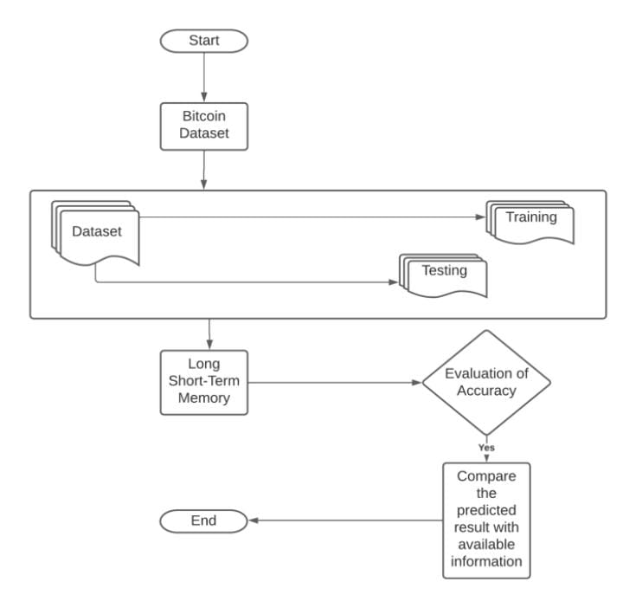
5.2 SYSTEM ARCHITECTURE

Slide 15

5.3 PROCESS DESIGN
Steps for performing Bitcoin-Price-Prediction :-
Download dataset from Yahoo Finance
Import necessary Library
Load dataset
Exploring data, checking for null values or missing value(handling them by removing them or replacing the null values by the mean of that column)
Visualize the data to explore the trend in the data.
Splitting the dataset into training and testing data
Building LSTM Model
Fitting the training data
Prediction on testing data Model
Evaluation(Calculate RMSE,MSE,R2 score)

Slide 16
5.4 Sentiment Analysis
Sentiment Analysis is the process of determining(computationally) whether a piece of writing is positive , negative or neutral. It is also known as opinion mining.
The APIs or python library which we planned to use are as follows,
Tweepy - Python client
Textblob - Textual Data Parser and provides built program of sentiment analysis for textual data
NLTK - Natural language toolkit corpora

Slide 17
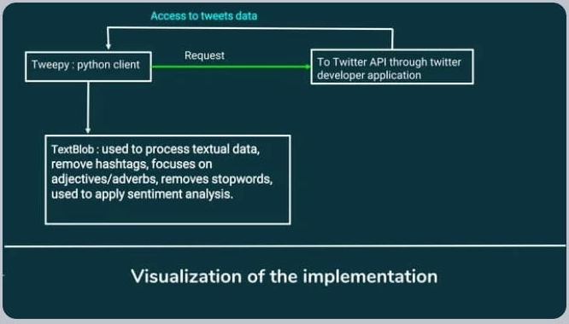

Slide 18
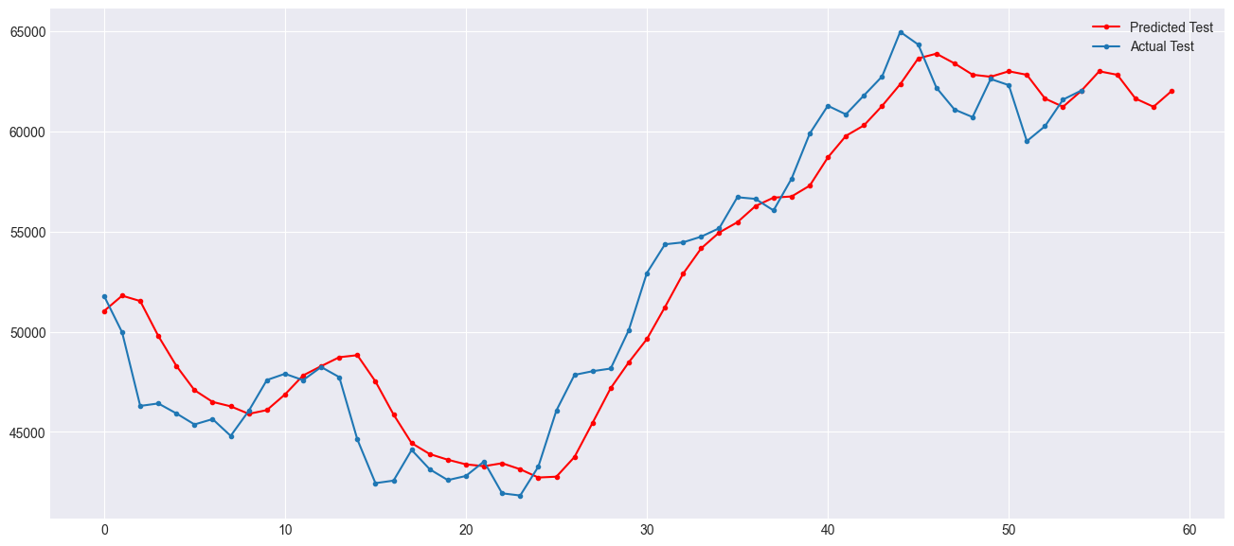
EXPECTED RESULT

Slide 19
THANK YOU

